Slide 1



GDG DevFest 2017
For Web

Slide 2



+
=

Slide 3


Slide 4
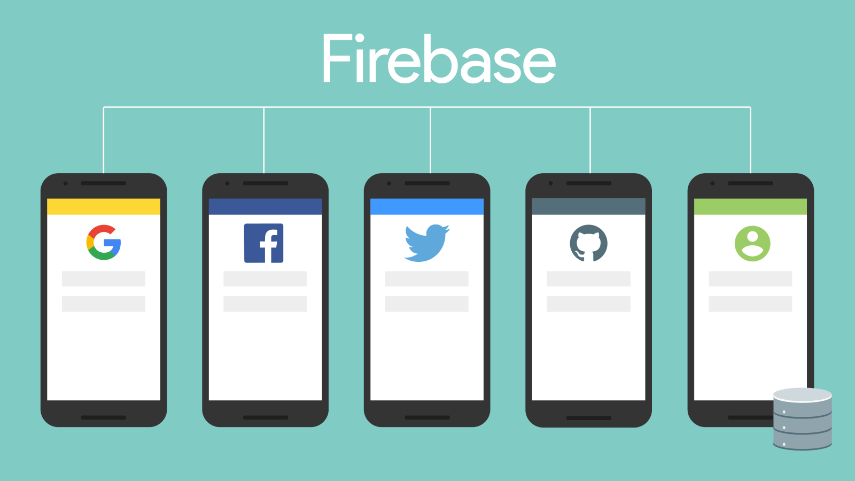

Slide 5


Slide 6
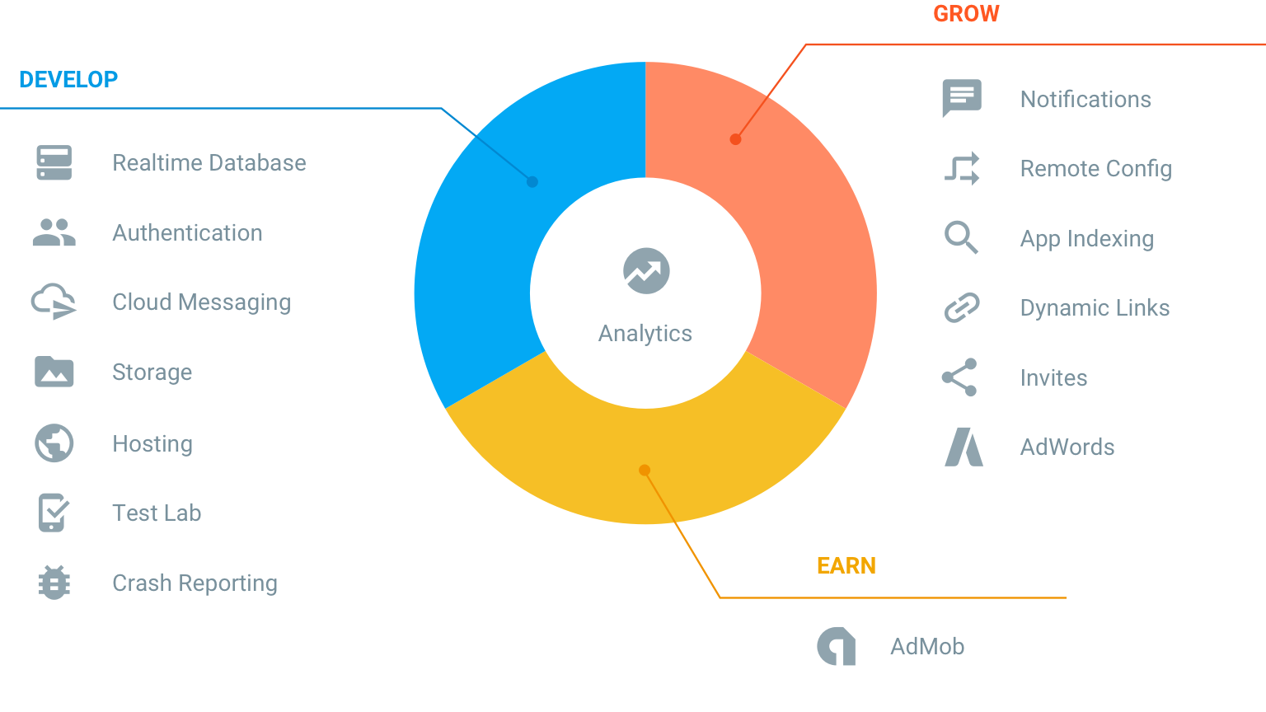

Slide 7


Let’startThe ame

Slide 8


Woohoo…. did it

Slide 9

Thank You
- Akshay Saini
(anonyxhappie.github.io)

